Slide 1

Scoping an Actionable ML Project
Rayid Ghani and Kit Rodolfa

Slide 2
Scope
Data
Exploration
Modeling
Get Data
Store Data
Link Data
Rows
Features
Labels
Model Selection
Train-Test Splits
Performance Metrics
Model Interpretation
Entities
temporal
Spatial
…
Models
Dealing with Bias and Fairness
Field Trial Design
Deployment
Monitoring
Goals, Actions, Data, Analysis, Ethics

Slide 3
Why Scoping is Critical
(Unfortunately) projects do not come as well-defined problems
A well-scoped project increases the likelihood of your work being used and having an impact
Shifts focus from “I have some data, what can I do with it” to starting with the problem, informing actions, and improving outcomes

Slide 4
The goal of this project is to build a model…
Doing some type of analysis may be the bulk of what you do during a project but the analysis is rarely the goal of the project.
A well-formulated/scoped project will have the analysis inform a follow-up action and help achieve intended policy/business/research goals

Slide 5
Before Scoping: Initial Screening Criteria
Real and significant problem (with clear social impact)
Priority for the organization
Commitments in place:
Access to the data and to people who understand the data
Access to the people who understand the problem
Commitment to validate and take actions informed by your work

Slide 6
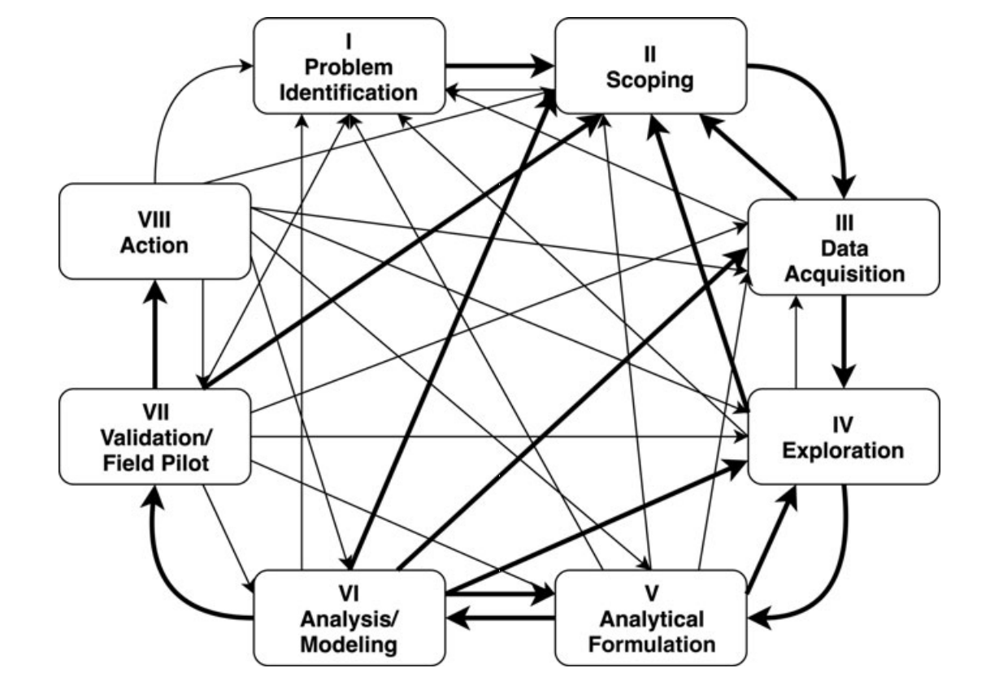
Scoping is an iterative and ongoing process
Involves different types of people
Gets refined over time
Gets modified as a result of later project phases

Slide 7
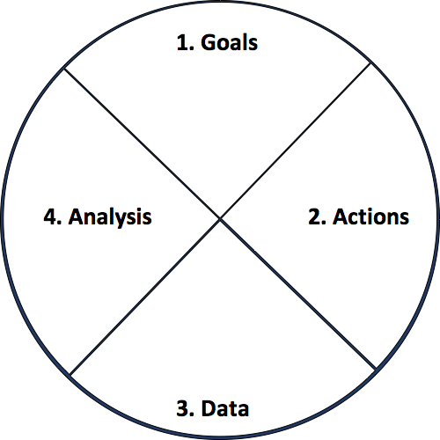
Actionable and Goal-Driven Project Scope
Goals: Define the goal(s) of the project
Actions: What actions/interventions will you inform?
Data: What data do you have internally? What data do you need? What can you augment from external and public sources?
Analysis: What analysis needs to be done? How will it be validated?
7
dsapp.uchicago.edu
@datascifellows
Center for Data Science and Public Policy University of Chicago

Slide 8
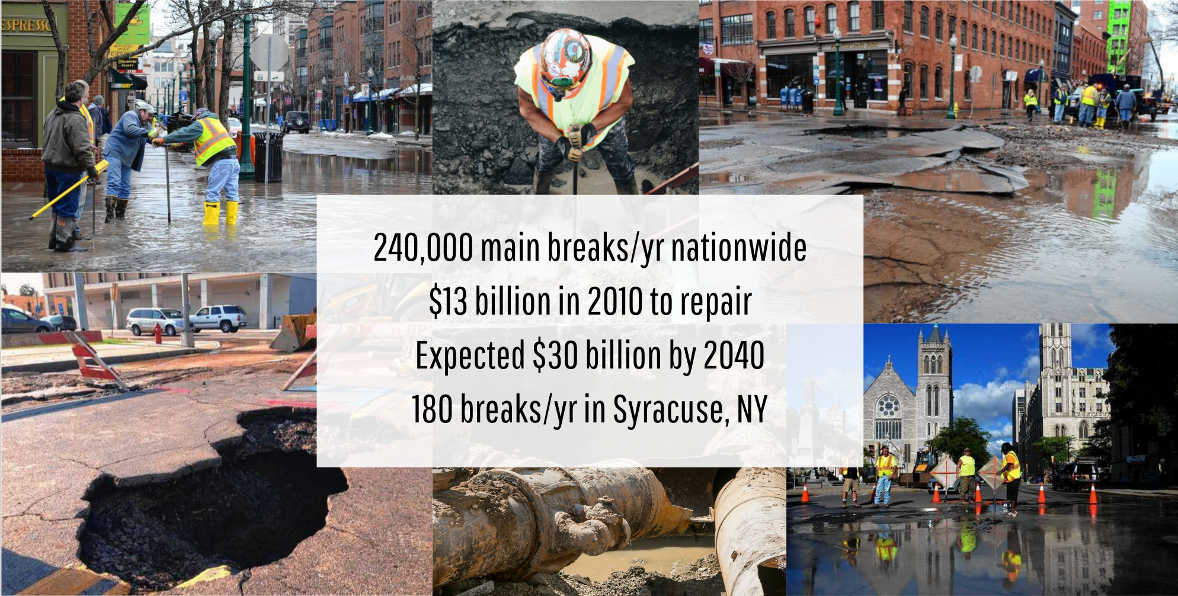
Case Study
240,000 main breaks/yr in US
$13 billion in 2010 to repair
Expected $30 billion by 2040
180 breaks/yr in Syracuse, NY

Slide 9
Step 1: Determine Goals
If you are successful doing this project, how would the world change?
Will the process you’re trying to improve become more efficient?
Will it be more effective?
Will it be more equitable/fair?
A combination of the above?

Slide 10
Step 1: Determine Goals
Goals need to be measurable and concrete
Goal is NOT to build a model or a map or dashboard, make a prediction, etc.
What are the relative priorities and tradeoffs for each goal?
What constraints do you face in achieving these goals?
Need to get different “stakeholders” involved up front

Slide 11
Problem Templates
Can I detect who’s going to get lead poisoning early?
Can I determine which home inspections to prioritize?
How do I improve the scheduling and assignment of my medics/ambulances/firetrucks?
Can I route citizen requests more efficiently and effectively?
Which policies do I modify to improve maternal mortality ?
How much impact is my after-school program having?
Can I get data that helps me match employers with employees ?
X
X
X
X
X
X
X

Slide 12
Types of Problems
Early Warning Systems
Compliance/Inspections/Audits
Routing (Physical or Virtual)
Scheduling
Policy Evaluation
Policy Hypothesis Generation

Slide 13
Step 2: Identify Actions to achieve the goal
What interventions/actions do I have access to?
What would someone do differently if they had more information or knew where their actions were most likely to be effective?
Informing these actions:
Who? (to target for each action)
What? (to say to them)
How? (to use different communication channels)

Slide 14
Step 2: Identify Actions to achieve the goal
Focus on concrete actions
Existing vs new actions
Consider the granularity of the actions
e.g. students who need help generally vs specific program
How frequently are interventions taken/planned?
How far out does planning occur?
Notes:
Stakeholders need to be bought in from the beginning or it won’t be effective

Slide 15
Step 3: Data Sources
What relevant data sources do you have?
What data do you need?
Important to match the granularity, frequency, and time horizon of the actions to the data
What external data can you augment this with?
dsapp.uchicago.edu

Slide 16
Step 3: Data Sources
Types of Data
Nobody knows what data the entire organization has
Don’t get intimidated by legal acronyms thrown at you
Data is never perfect – is it useful enough to improve over status quo?
Program Level
Transactional
Spatial
Text
Images/Audio/Video

Slide 17
Step 3: Data Sources
How reliable is the data?
How current is it?
How much of it is computer-readable?
How much of it is stored as notes, audio, photos, videos?
What resources and authority do you have to collect more?

Slide 18
Step 4: Analysis
What analysis needs to be done?
What type of methods should be used?
How will the analysis be validated?

Slide 19
Types of Analysis Capabilities
Description (Understand the past)
Detection (Anomalies, Events, Patterns)
Prediction (Predict the Future)
Optimization
Behavior Change (Causal Inference)

Slide 20
Validation and Implementation Plan
Go back to the metrics and goals defined at the beginning of the project
Run a Pilot/Field Trial
Deploy
Set up Infrastructure and allocate resources to monitor “lift”

Slide 21
Creating a more equitable society
How do we define equity?
How do we detect inequity?
How do we increase equity?

Slide 22
Data and AI Ethics Issues
Privacy
Data Ownership
Bias, Equity, & Fairness
Transparency
Trustworthiness and Accountability

Slide 23
Levels of control
Collection Control
Access Control
Inference Control (Not inferring something about me)
Action Control (Not taking actions on me)

Slide 24
Data Ethics Questions
Are you using data for purposes it’s intended for?
How are you protecting the data?
Do the people who “own” the data know you’re using it?
Do you have their permission? How was it obtained?
What actions are you taking on individuals based on this data?
Do the people you’re targeting know why and if they’re being targeted?
What recourse do they have?
Would it make the front page of the national newspaper if they found out what you’re doing?

Slide 25
A Few Things to Remember
Don’t be afraid to ask naïve questions
Spend time discussing goals and metrics – don’t forget equity as a goal
Understand what the current process/solution is
Communication is critical – before, during, and after
We need to make sure that we tackle these problems responsibly and ethically
Data and ML does not solve problems, people do. Is what you’re doing helping solve the problem?

Slide 26
Project Scoping Worksheet
http://bit.ly/dataprojectscoping

Slide 27
Reminders
Next Tuesday
Submit weekly review (assignment) before class

